Slide 1
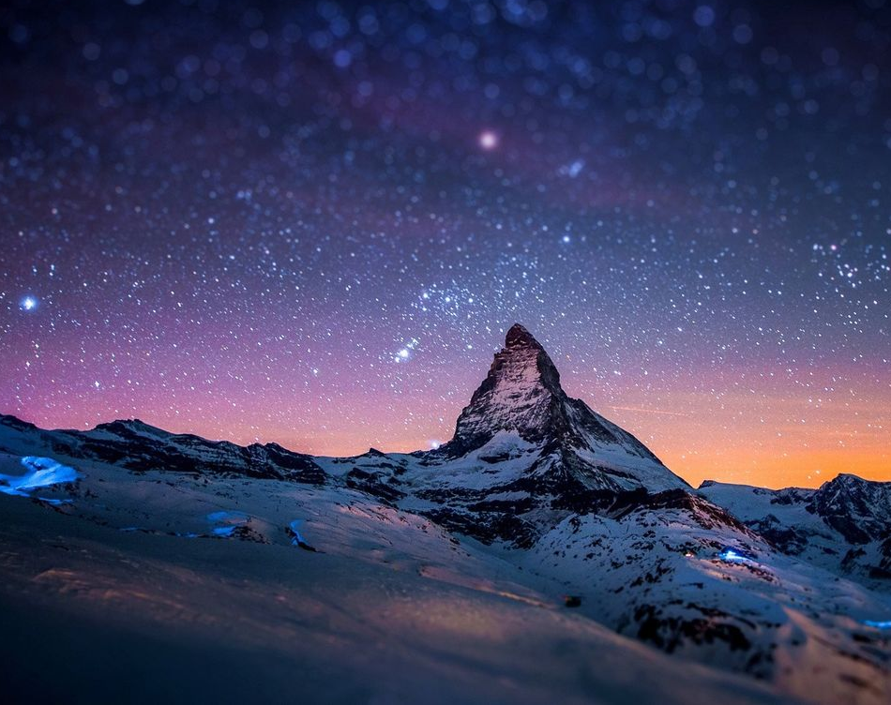
All sufficient merit

Slide 2
CAPO @ 4th
Am G F C F G
All sufficient merit Shining like the sun
Am G F C F G F C
A fortune I inherit By no work I have done
G Am F C
My righteousness I forfeit At my saviors cross
G Am F G C F
Where all sufficient merit Did what I could not

Slide 3
Am G F C F G
In love he condescended Eternal now in time
Am G F C F G C
A life without a blemish The maker made to die
G Am F C
The Law could never save us Our lawlessness had won
G Am F G C
Until the pure and spotless Lamb had finally come

Slide 4
G Am Em
It is done It is finished
F C
No more debt I owe
G
Paid in full
Am Em F G
All sufficient merit now my own

Slide 5
Am G F C F G
I lay down my garments Any empty boast
Am G F C F G C
Good works now all corrupted By the sinful host
G Am
Dressed in my LORD Jesus
F C
A crimson robe made white
G Am F G C
No more fear of judgement His righteousness is mine

Slide 6
G Am Em
It is done It is finished
F C
No more debt I owe
G
Paid in full
Am Em F G
All sufficient merit now my own

Slide 7
Am G F C F G
All sufficient merit Firm in life and death
Am G F C F G C
The joy of my salvation Shall be my final breath
G Am F C
When I stand accepted Before the throne of God
G Am F G C
I’ll gaze upon my Jesus And thank Him for the cross
F G C
Yes I’ll thank Him for the cross

Slide 8
G Am Em
It is done It is finished
F C
No more debt I owe
G
Paid in full
Am Em F G
All sufficient merit now my own
END

